Slide 1

Using phages to treat antibiotic-resistant infections
Jessica Sacher and Jan Zheng
Notes:
Plan: Antibiotic resistant infections, phages, our solution

Slide 2
How we started the talk (we didn’t actually show this slide to class)
Asked kids these questions:
How many have heard of antibiotic resistance (almost none)
How many of you have taken antibiotics? (lots)
How many have heard of someone having an infection that antibiotics didn’t work on? (some)
How many know someone with cancer? (LOTS)
Why is that? (Because it’s a common disease)
Then told them:
Antibiotic resistance is becoming more common
By the time you’re in your mid 40s, more people will be dying of antibiotic resistant infections than cancer
Most of you will probably know someone who has this happen to them

Slide 3
Then: (we didn’t show this slide either)
Went through slides about resistance, phages, phage therapy (see next few slides)
Stopped to focused on explaining phage infection with props:
showing phage binding to cell, explaining that phages burst out of bacteria and go on to infect more… (they were very engaged with this part)
Showed Phage Kurzgesagt video
Went through slides about our project, Phage Directory
A nice long question and answer period!!
Total time: 1h15 min for first class, 40 min for second (used all the time we were given)

Slide 4
Antibiotics
The “miracle drug” against bacterial pathogens (bacteria that cause disease)
Pneumonia
Sepsis
Wound infections
Ear infections
Etc.
The problem: antibiotics have stopped working, and people are dying of infections that used to be curable

Slide 5
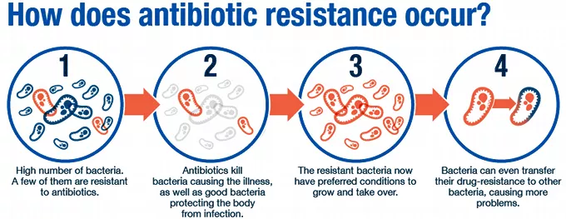
Antibiotic Resistant Infections
World Health Organization

Slide 6
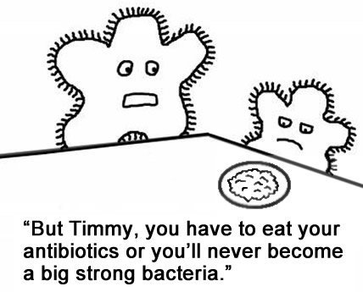
Antibiotic Resistance
sott.net

Slide 7
A growing problem
Antibiotic resistance will cause more deaths than cancer by 2050 (when you’re in your mid-forties)
It’s already killing about 700,000 people each year
What can be done?
Use the natural, “living” predators of bacteria against them: Phage Therapy

Slide 8
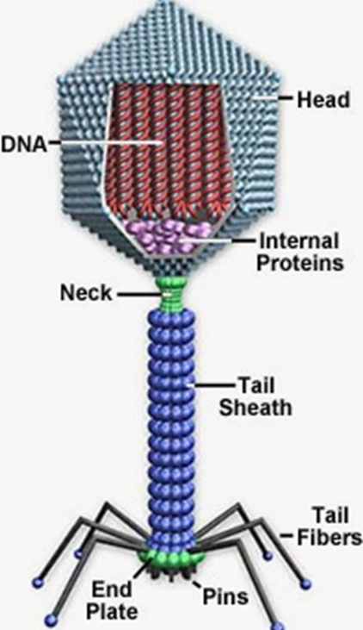
What are phages?
Bacteriophages (phages for short) are the natural predators of bacteria
There are LOTS of them in every environment on earth! (10,000,000,000,000,000,000,000,000,000,000)
They don’t kill or bother human cells
Hatful and Hendrix (2011)
Notes:
The answer: Bacteriophages
What are they? Bacterial viruses. Natural predators of bacteria. SPECIFICITY. Life cycle: lytic and lysogenic/temperate.
Abundance and diversity in nature. Present everywhere bacteria are present. GUT. Outnumber human cells 10:1. 10²³ phage infections per second
Bacteriophages offer a special perspective on the diversity, origins, and evolution of viruses, not only in their tremendous abundance – there are more than 10³¹ phage particles in the biosphere – but in their distant origins, likely more than three billion years ago [1,2]. Moreover, viral ecologists calculate that there are about 10²³ phage infections per second on a global scale, indicating that the population is not only large and old but also highly dynamic [3]. (Hatful and Hendrix 2011)

Slide 9
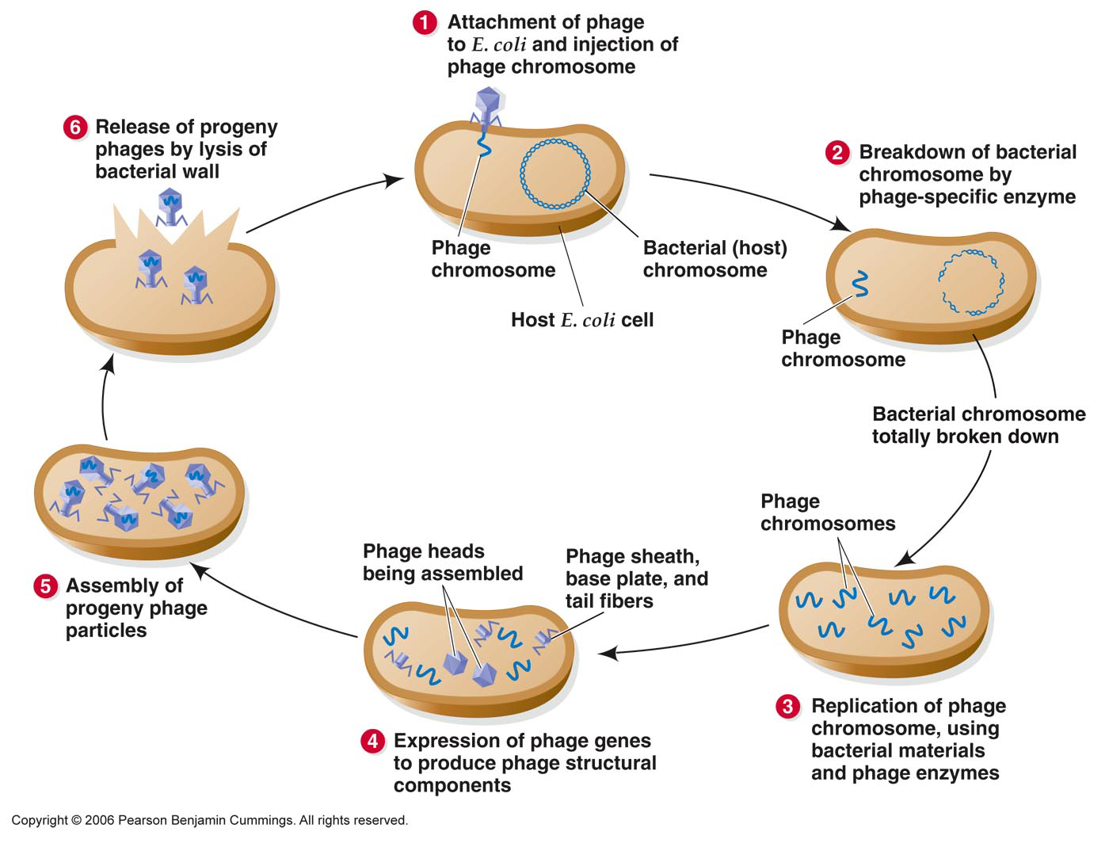
Phage infectious lifecycle

Slide 10
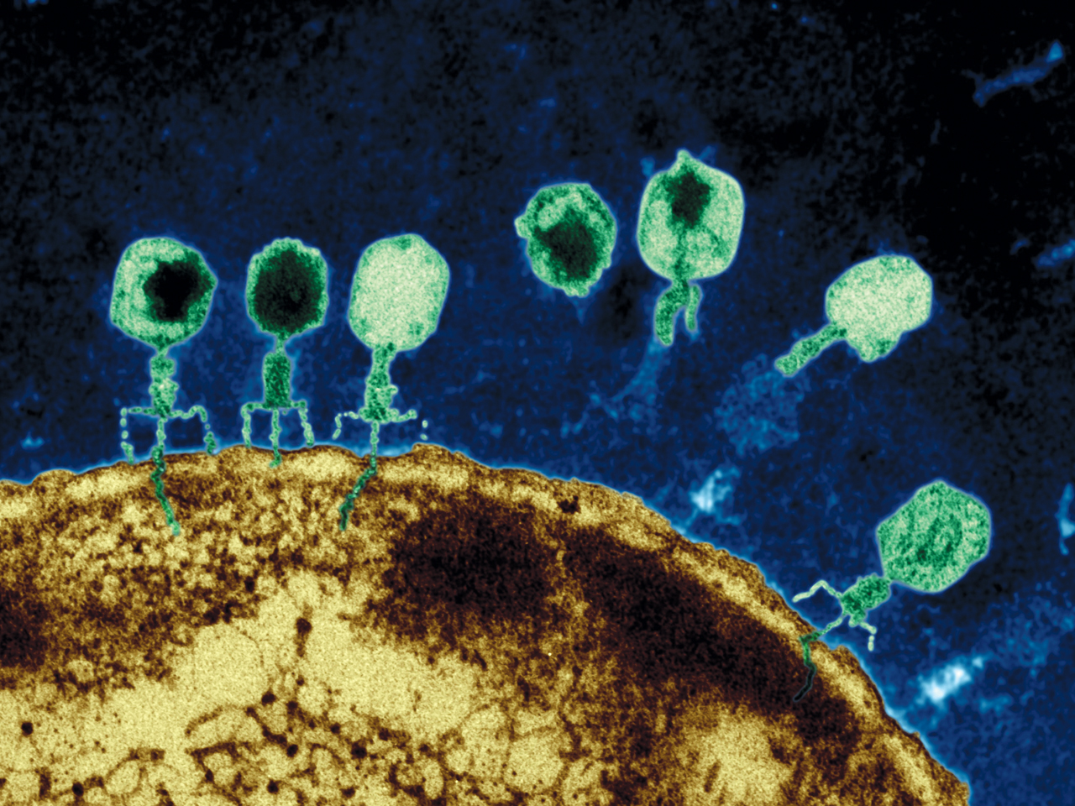
How do you “see” a phage?
1. Electron microscope

Slide 11
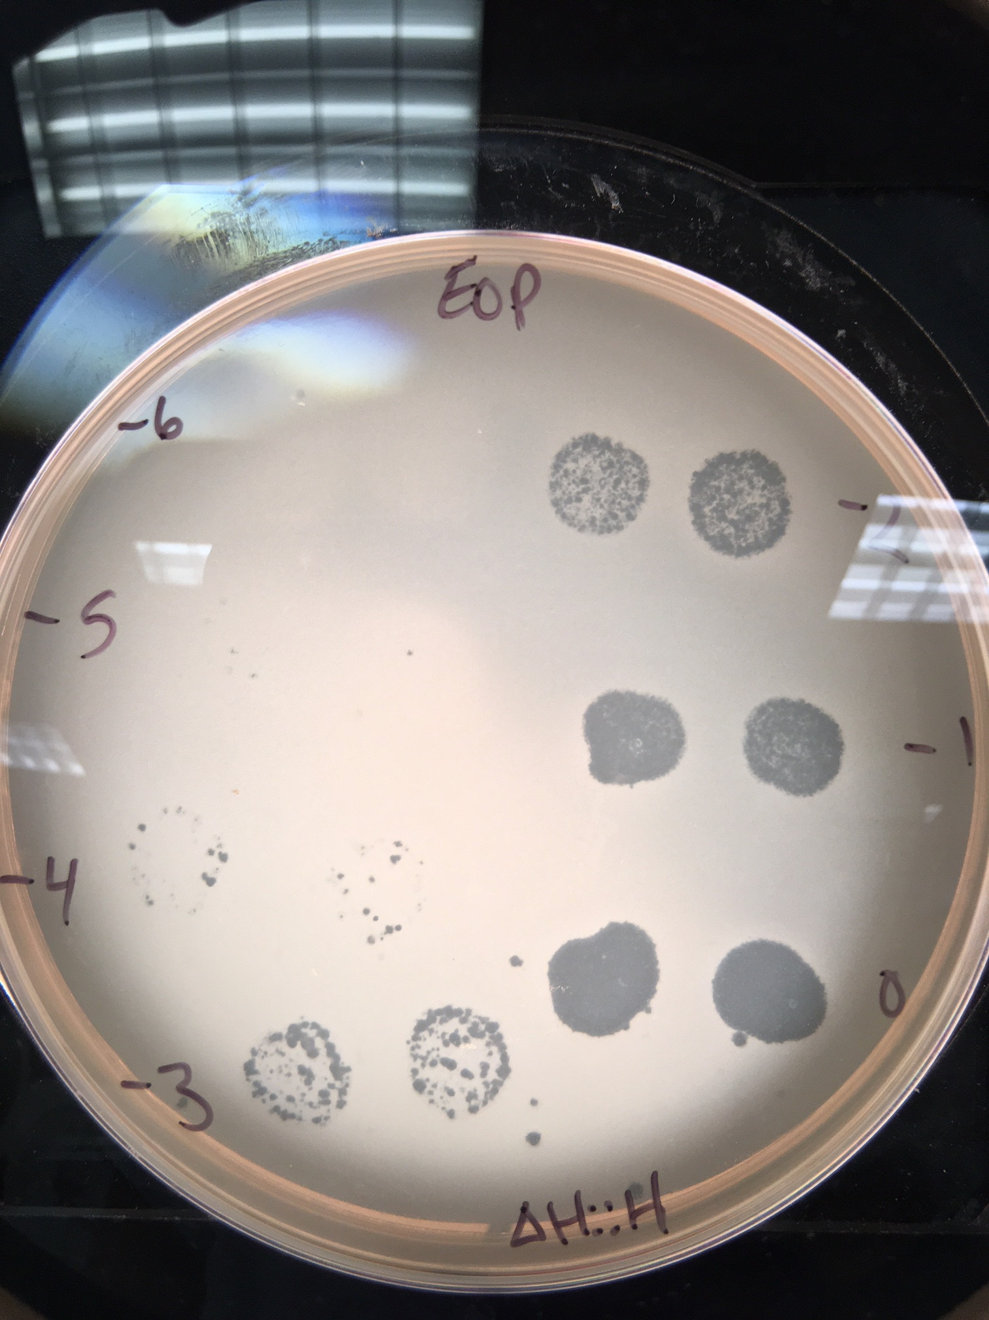
How do you “see” a phage?
2. Plaque assay

Slide 12

Phage Therapy
Using phages as medicine to treat antibiotic-resistant infections
Phages
Bacterial cell

Slide 13
Videos!
Phage therapy / Kurzgesagt
Antibiotic apocalypse / Kurzgesagt
Superbug snipers / Netflix
Notes:
First link is best choice!

Slide 14
The next slides are Phage Directory specific... We told the kids how we got started, what we’re building… (replace these slides with your research/whatever you like!)

Slide 15
Why we decided to start a company
1 microbiologist / phage biologist
1 product designer / computer programmer
2 tweets
1 idea

Slide 16
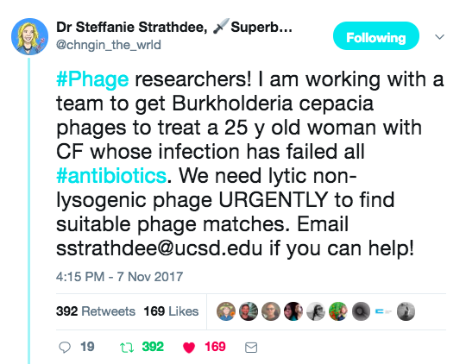
The first tweet… a girl needs phages

Slide 17
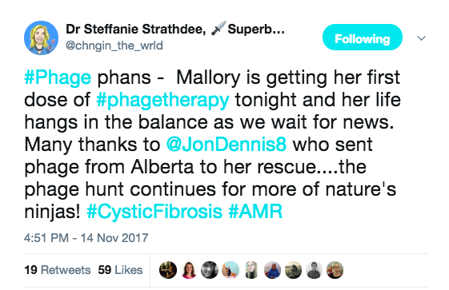
The second tweet… people are actually sending phages!!

Slide 18
But… why were they using Twitter?
Nothing else existed

Slide 19
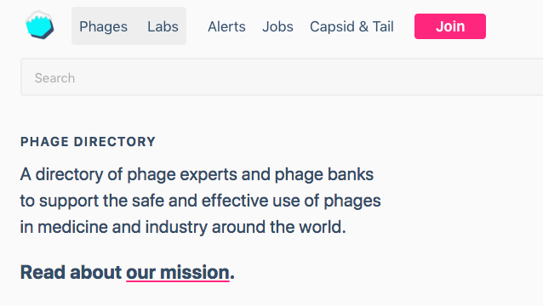

http://phage.directory

Slide 20
Fast forward 1 year…
Phage Directory has:
1,260 Twitter followers
104 subscribers to Phage Alerts
170 subscribers to Capsid & Tail

Slide 21
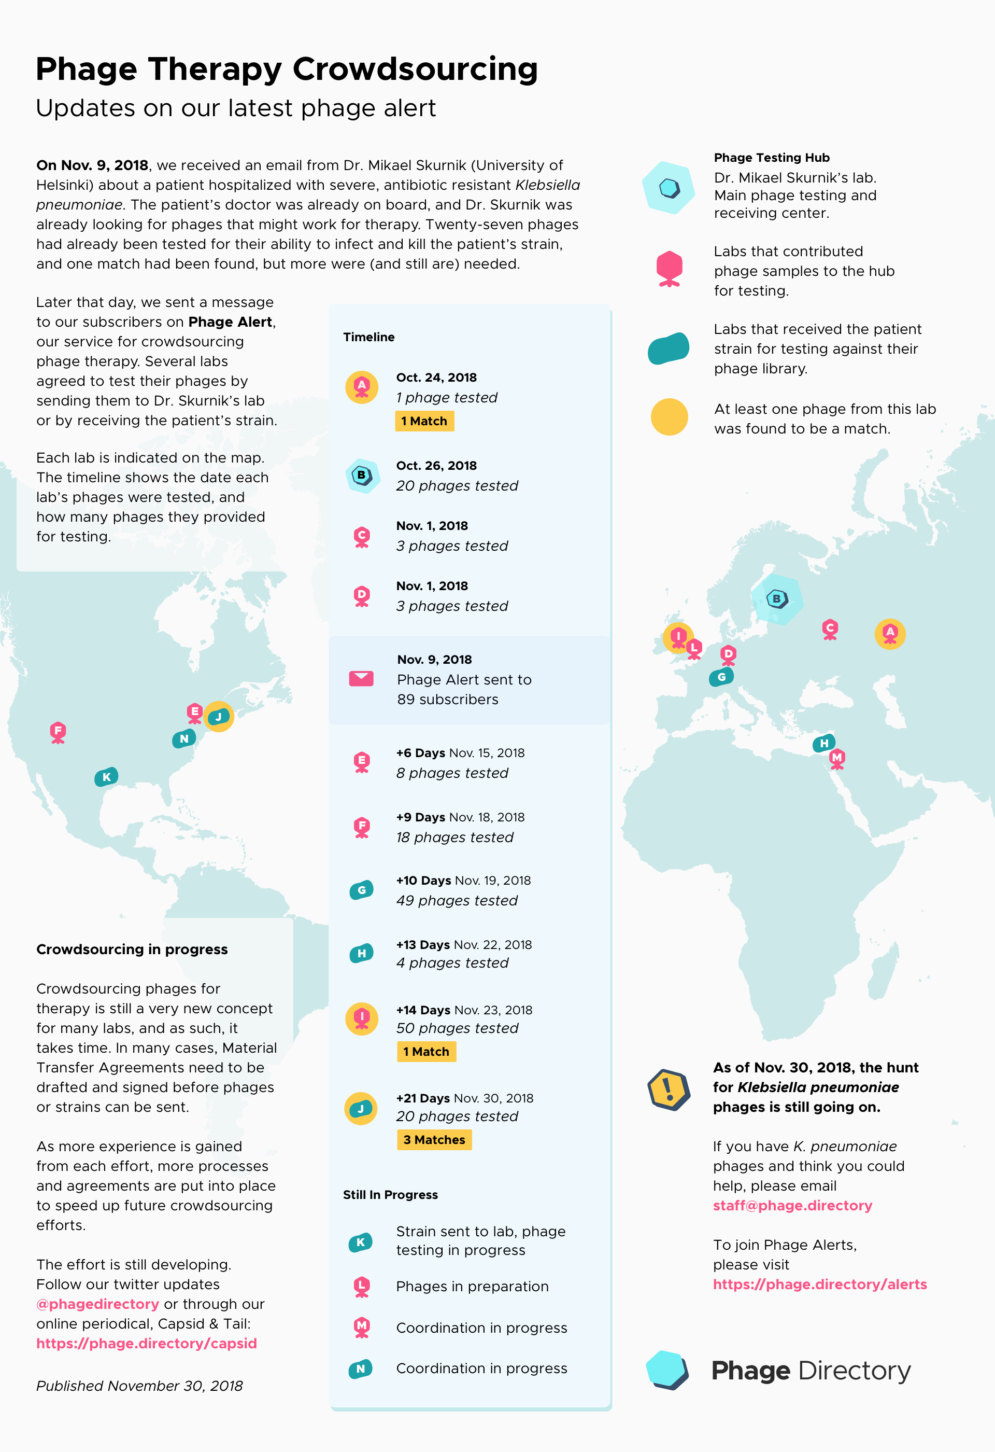
This month: Phage hunt!
Currently ongoing…
Almost 200 phages tested
At least 8 active phages found

Slide 22
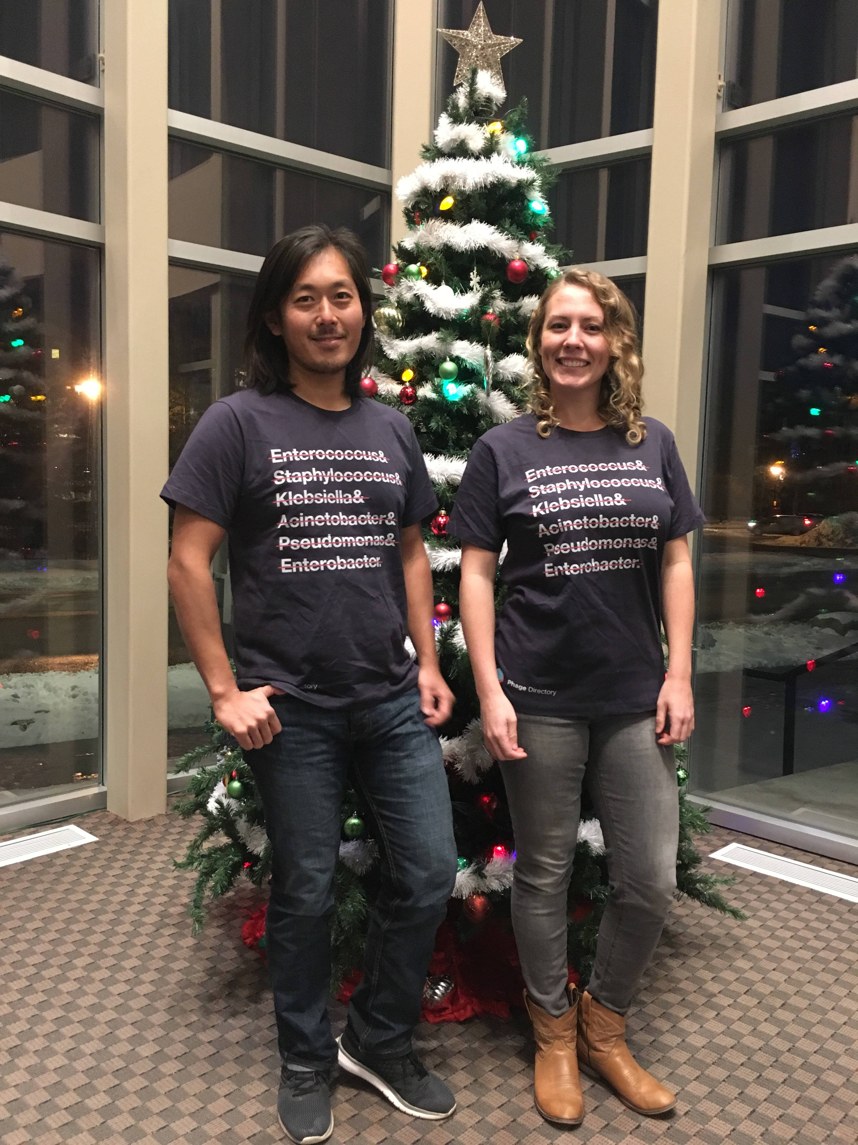
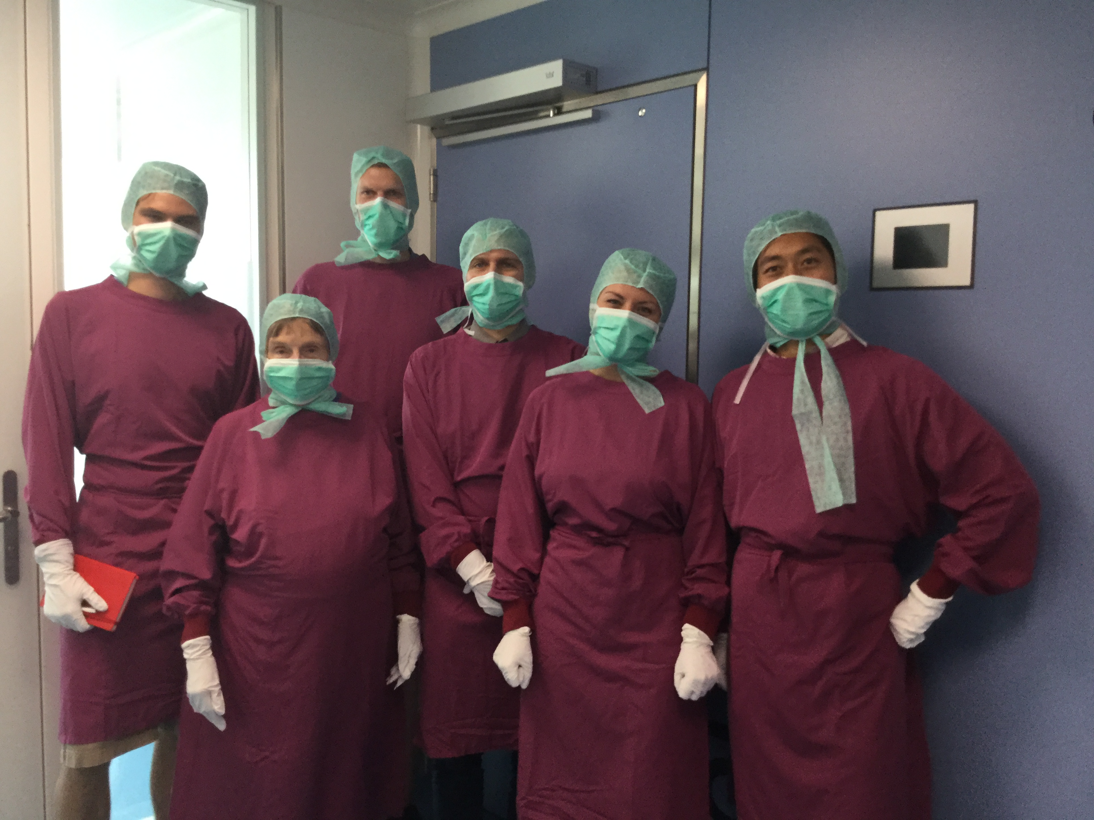
Thanks for listening and participating!!
Notes:
Replace with your own pictures!! Perhaps you in a lab!

